Slide 1
Journalists Voice

Slide 2

tIMES
Exceptionals of Do It All Types - Not Obsessive

Slide 3

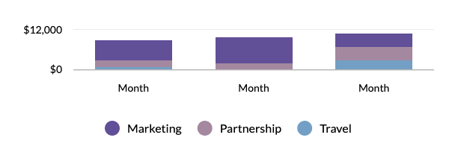













Budget
Manages marketing share on board with boarders
Breakdown by Month
Online
Slice5
Slice1
$59
$22
Slice2
$46
Slice4
Slice3
$87
$55
Breakdown of Total $30,000,000,000
Offline
Travel
Slice5
$4,000
$41
Slice1
$91
Partnership
Marketing
Slice4
$8,000
$18,000
$72
Slice3
Slice2
$29
$44

